Slide 1

SDLC – AGILE MODEL
Course Title : Introduction to Software Engineering
Course Code : SE 113

Slide 2

Self Introduction
Farjan Ahmmed
0242320005341738

Slide 3

DEFINITION
AGILE SOFTWARE DEVELOPMENT LIFE CYCLE (SDLC) IS THE COMBINATION OF BOTH ITERATIVE AND INCREMENTAL PROCESS MODELS.

Slide 4


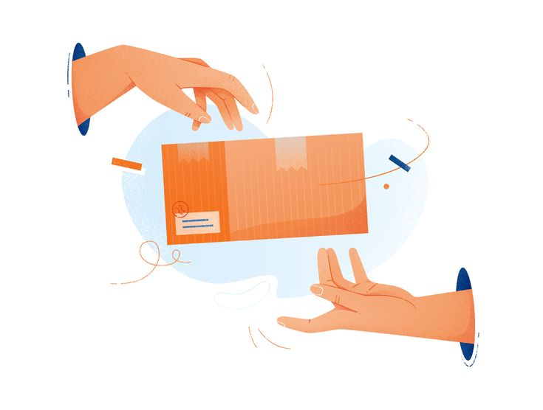
Some Key Features Of Agile Model
Prioritizes flexibility, collaboration and customer satisfaction.
It is a combination of iterative and incremental models.
Agile method breaks the product in small parts for quick delivery.

Slide 5
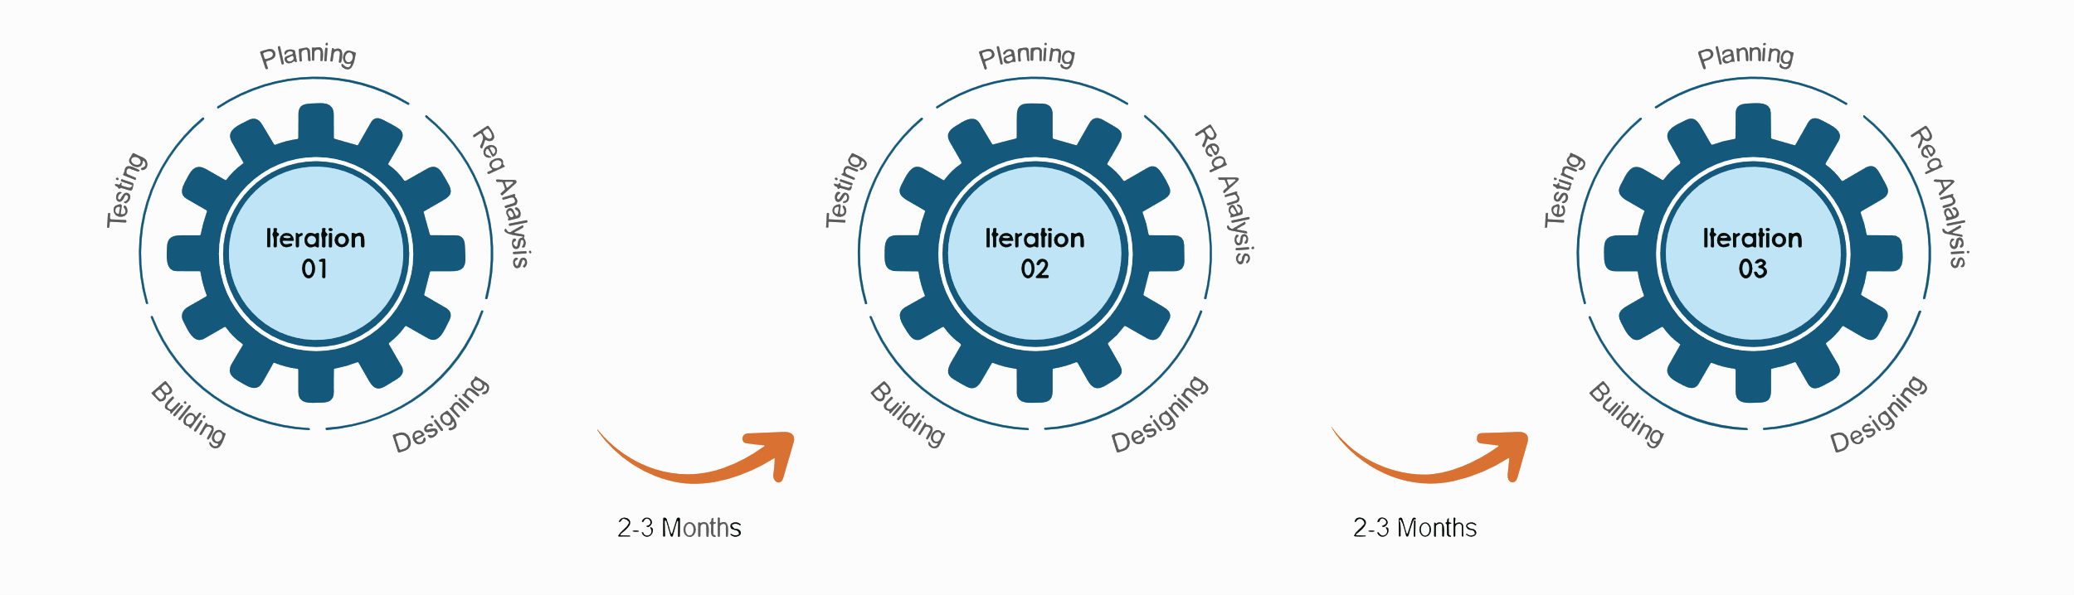
Graphical Illustration Of The Agile Model

Slide 6
Traditional Model vs Agile Model
Traditional (Waterfall) Model | Agile Model
Sequential and linear | Iterative and incremental
Collected late in the development process | Continuous customer feedback throughout
Tends to have longer delivery times | Often results in faster delivery times
Specialized roles with less collaboration | Cross-functional teams that are self-organizing
Changes are difficult and costly | Welcomes changes at any point in the development process
Emphasizes comprehensive upfront documentation | Values working software over extensive documentation
Fixed scope, schedule, and budget | Flexible scope, schedule, and priorities, accommodating changes

Slide 7
Some Popular Agile Methods
Scrum
XP
Kanban
FDD
Crystal
DSDM

Slide 8

Advantages Of The Agile Model
Easy to manage.
Gives flexibility to developers.
Customer Satisfaction.
Reduced Risk.
Higher Quality Software.
Increased Transparency.
Empowered and Motivated Teams.

Slide 9

Disadvantages Of The Agile Model
Lack of Predictability.
Dependency on Team Collaboration.
Resource Intensive.
Initial Learning Curve.
Not suitable for handling complex dependencies.
More risk of sustainability, maintainability and extensibility.
Continuous Involvement of Stakeholders.

Slide 10


